Slide 1


~Daily Health App~
By Aaron Novak
Notes:
Hello every-one, my names Aaron. And welcome to my Daily Health App.

Slide 2
Welcome
App for every-one to use, easy to use.
Simple terminal app with main menu.
The skies the limit with future development.
Notes:
I am creating this app so that its very easy to use, people of all ages and levels of education can learn it with ease.
I would like every-one to use this app so they can help themselves stay on track , basically with anything they see fit.
Its not just for medications and vitamins, its a general all round health app that also doubles up basically like a personal assistant, so you never forget to take your supplements, vitamins, mineral etc. daily, this is the app for you.

Slide 3
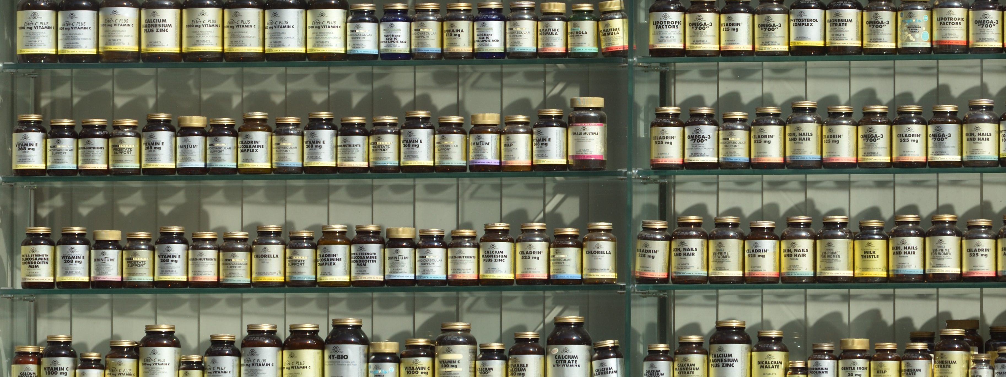
Digital Version of the Mon-Sun Pill box
Never forget to take your medication and vitamins etc again. You just log in and it will let you know!
Notes:
I created the structure around the fact that a lot of people I talk to want to get healthy and stay healthy, but its very easy during your busy day to just forget to take vitamins, minerals, greens powders, etc. What ever it is you already take, and want to keep taking and not forget.
So it was structured around the Monday to Sunday pill boxes that many people use and take with them on a daily.

Slide 4

Fully customizable
You can add in anything you would like. If you want to do 10 star jumps twice a day, enter it in.
If you would like to eat 3 apples a day, enter away!
Notes:
The application i created is just for a person to input all their medical data they would like to remember and continue to pursue on a daily, but you can also add in anything else you would like to accomplish on a daily. Would you like to do 100 star jumps a day spread into twice a day, then you can add that into the array, you can pull out that data any time you like. So its going to be extremely versatile once its completed.

Slide 5
Add/delete/modify items
Add
Add your items
Add the amount of times you wish with said item
Delete
If you no longer need an item, delete it.
Modify or update an item.
Change the required amount of each item.
Modify
Notes:
Created with the use of several classes which iterate through the information I was able to create in the arrays and hashes, all you need to do is at the main menu to add, replace or delete an item is press on the menu item from 1 to 5 digits on a keyboard, then it will ask which item you would like to add to a user, replace a current item with another item, or delete the users item if you for any reason don't want to do that item any more, its very easy to use with basic commands, such as "who is the user" "what is the item" and then you click either y or n to delete or replace.

Slide 6

Various info
There is going to be a various info tab that you can go to:
- Quick Energy.
-Various Nootropics for studying.
-Stretches to make yourself feel more awake.
-Tones to help you sleep, study and relax.
-Breathing techniques.
-Keeping CALM during group talking
Notes:
I would eventually after a lot more study love to put some information about doing presentations such as this one and remining cool and calm. I am most definitely not there yet!

Slide 7
Bonus information
Implement a small bit of info to get people thinking.
-Did you know fidgeting can burn up to 350 Calories a day?
-Splashing cold water on your face 3 times, wakes you up much faster!
- Studying and feel like no information is going in, try binaural beats.
-Heard of Nicotine? Yes, cigarettes, dive deeper. Its not as deadly as you think!
Knowledge = Power
Notes:
I also will put in a bonus tab for people that are going into meeting or studying so that they can achieve the most information to be absorbed via various methods of keeping yourself alert and in a great mind set for learning.
Also, a random array of fun facts that people may not know, I've always liked random facts and I think they would be beneficial to any and every-one. I am going to make it sort of a guessing game if I can.

Slide 8
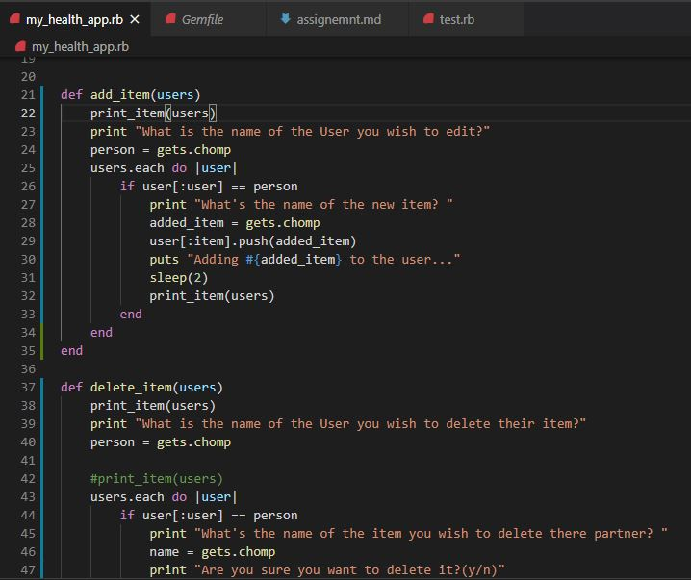
The code
Sneak
peak
of the
code.
Notes:
Ok here is the current nitty gritty, its just a small snippet on the code I have been working on over the last few weeks.
It doesn't look like much and it was very easy to over-look and just say ill do it later in time, but when you really get into it, its very hard to make it all work the way you want it.
Also, the hardest parts for me was choosing which order to put it all in and which classes to even choose to begin with!.
I really over-looked the fact how hard it is to put the data in the way you want it to work and had to change it literally several times. I also even completely changed the whole app to make it much more doable.

Slide 9

Happy = Healthy
Basically, I just want to create an App so that all can use, and heavily benefit.
All the external bits apart from the actual add remove items part will be completely up to user discretion if they wish.
Notes:
So as you can see, its just an app for every-one to use and to keep themselves happy and healthy. The healthier you are, the happier you are.
All the information is just guidelines and you can do with it as you wish.
Each person has different brain chemistry so different dosing and vitamins / minerals work on different people, and I would highly suggest you visit your go to health person, whether its Traditional Chinese Medicine doctor, Ayurveda doctor, western medicine doctor, or other naturopaths.

Slide 10

So the truth….
-That’s what it was meant to look like any way!
-I ran out of time and had to change to a much more basic layout – Doh!
-Here is the current working APP though, very scaled down.
Notes:
Ok so, ...yes, as you can see, this is what i wanted to the app to do in the first instance, but i quickly found out that wasn't very easy to achieve in the time frame.
SHOW THE APP.

Slide 11

Future developments
-Add in mobile device with push notifications & alarms.
-All breathing techniques.
-Guided meditations.
-Reflexology.
-Essential oils & benefits.
-Detoxes, not only fasting and running to the toilet!
-Electrolytes and benefits even on non exercisers.
Notes:
Here is just a small list of the future developments I would like to implement when i get more time and a lot more knowledge. I will begin slowly and work my way up.
I would love to create this app so that every-one can enjoy lots of various information I have read over the years of being into fitness.
But yes, that’s for the future, for now and tomorrow im going to just try and get this code working. If that is possible I will be really happy.

Slide 12
Special thanks to
Power-Point stock images.
Notes:
This slide is just to say thanks to the stock images that are on the Microsoft power-point app. They made it extremely easy for me to find great high-quality photos for this slide show to depict exactly what it is I would like to portray to every-one.

Slide 13
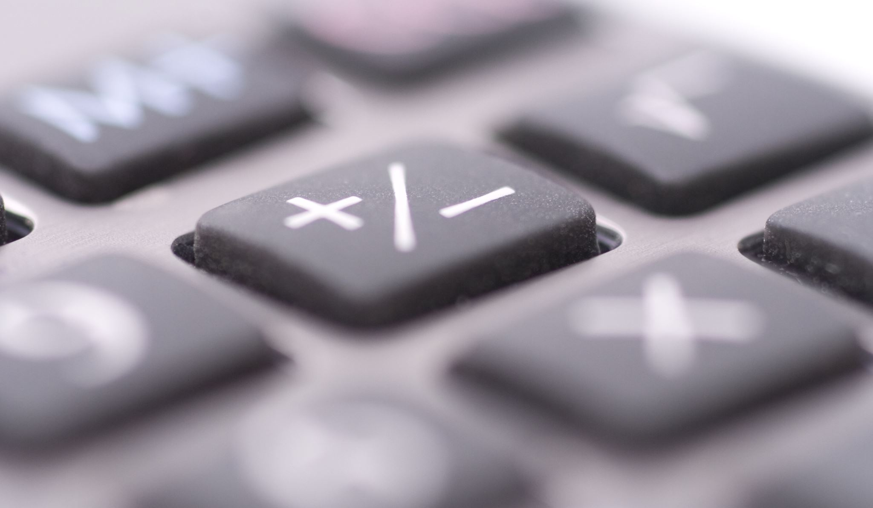

Thank you all for you’re time!
Notes:
And thanks very much every-one for your time, and I hope you enjoyed my presentation, if you have any questions, i will try and answer them.

